Slide 1

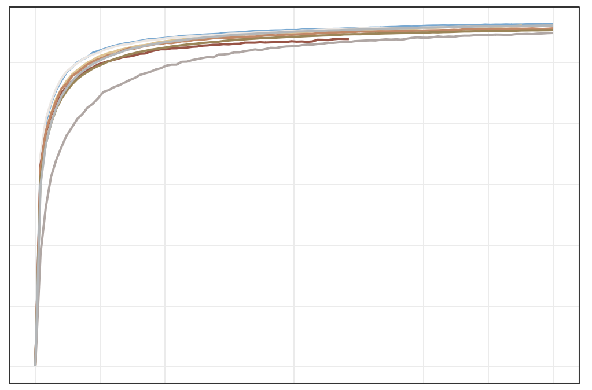
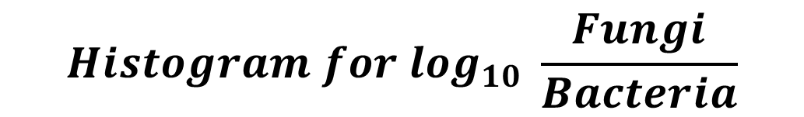
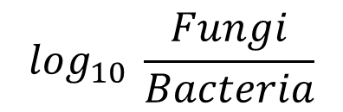
a
$$Histogram for \log_{10} \frac{Fungi}{Bacteria}$$
10
Histogram for log₁₀ $Fungi$
median = −2.80
10
median = 4.31
Percentage
8
8
6
Percentage
4
2
6
0
1
2
3
4
5
6
Histogram for log₁₀ Bacteria
Percentage
8
median = 7.19
4
6
4
2
2
0
4
5
6
7
8
0
−6
−5
−4
−3
−2
−1
$$\log_{10} \frac{Fungi}{Bacteria}$$
b
c
Sample sequence quality control
2,052 samples
filter abnormal
patients
1,935 samples
filter none
stage patients
1,919 samples
chao1
400
filter the
high-Fungi
sample (> 1% )
1,836 samples
filter the low-alignment-reads sample (< 1M )
1,837 samples
PCR free
2014_ZellerG
2015_FengQ 2016_VogtmannE 2019_ThomasAM 2019_WirbelJ 2019_YachidaS 2017_YuJ
2021_YuJ
Suspected contamination samples filtering
200
1,817 samples
filter the
low-Fungal sample (< 0.01% )
1,739 samples
filter suspected of bacteria contamination
(1 species> 50%)
1,670 samples
Low-fungal sequence depth samples discarding
0
1,329 samples
filter low-fungal
sequencing depth samples ( < 10k)
1,625 samples
filter suspected of fungal
contamination
(1 species> 50%)
0
5000
10000
15000
20000
Sequencing Depth in Fungi
S figure 1 Metagenome sequencing data profile and case filtering criteria. (a) Left panel: fungal (red border) and bacterial (blue border) alignment count number in 9 cohorts, a total of 2,052 cases. Right panel: ratio of fungal and bacterial alignment counts number (purple border) in all samples (b) Microbiota rarefaction curve generated based on fungal chao1 diversity. (c) Case filtering criteria contained three primary sections, sample sequence quality control (n_{filtered} = 235), suspected contamination samples filtering (n_{filtered} = 192), and low- fungal sequence depth samples discarding (n_{filtered} = 296). Excluding 723 cases, consistent with previous studies, approximately 30% of individuals were fungi free.

